Slide 1

ECEN 3593-001 Computer Organization
Lecture #35
12 April 2021

Slide 2


Agenda
Class Announcements
Course Project discussion
Chapter 5

Slide 3
Class Announcements
Reading assignment for the week
“Computer Organization and Design, The Hardware / Software Interface, RISC-V edition,” by David Patterson and John Hennessy
ISBN 978-0-12-812275-4
Chapter 5, “Large and Fast: Exploiting Memory Hierarchy”
pages 410-449 (sections 5.5 thru 5.8)
OH today 2:00 to 3:00 in Zoom - https://cuboulder.zoom.us/j/4317981384

Slide 4
Class Announcements
Phases 7/8 are in the deduction period – 1%/day
Phase 9 is in the deduction period – 4%/day
Phase 10 is posted
Target Date Sunday, April 18 at 10:00 PM
Bonus 1%/day, Deduction 4%/day
Homework #5 will be posted this week and due the following week

Slide 5
Final Exam
May 3, 1:30 to 4:00 PM, Online
~20 Homework style questions
~30 short questions
Twice as many questions as the MidTerm, but 3 times as much time
The Final Exam is typically quite challenging
There will be a Practice Final available the week before the real Final

Slide 6
Phase 9
To test:
Create an input value
Encode it
Insert an error
Decode the result
Check that the result matches the Specification in Section 1
Repeat
Make sure you try several data patterns
Make sure you exercise all the error cases

Slide 7
Phase 10
Exercise of another key Computer Architecture function – optimization
Benchmark – a test program designed to exercise the functions required by a particular processor application
You each have a unique Benchmark – standardname10_test in H:
There is a full Codasip cache design in G:/Information/Phase 10
Your task is to determine the cache configuration which minimizes the cost function defined in your Benchmark
You create different cache configurations, build them and then run the Benchmark on that design

Slide 8
Phase 10
Each configuration will take several minutes to build, and 2-3 minutes to run the Benchmark
Track the results of each run, and adjust the configuration based on your results
A minimum of 10 different configurations is required to be run
A report is required as part of the exercise, which has the opportunity for up to 75 bonus points
A report template is provided
The report is very representative of the type we use all the time in industry.

Slide 9
Phase 10
Your regular score is a function of how close your final design is to the optimal one
This version of Phase 10 is new, so there may be typos or confusing language in the document
Please ask questions about the document in #phase10

Slide 10
Phases 9 and 10
Questions??

Slide 11
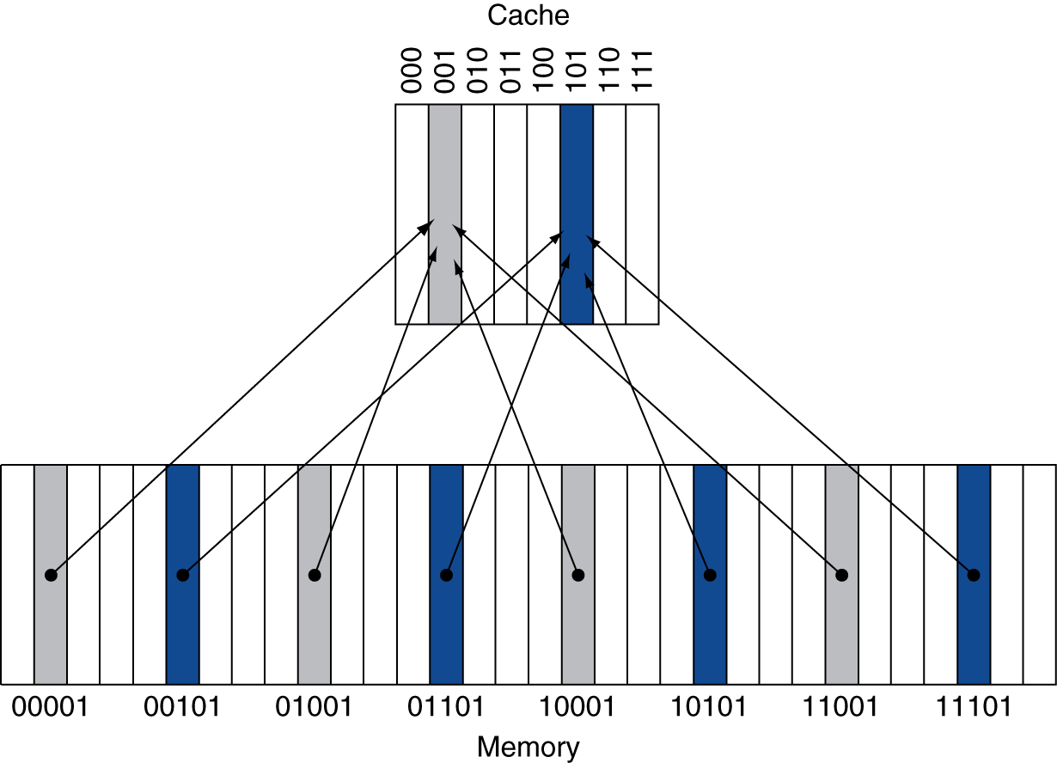
Direct Mapped Cache
Direct-mapped cache: a cache structure which each memory location is mapped to exactly one location in the cache
Block address/Index: The address used to address a block of memory in a cache or a level of memory hierarchy
How many bits would the Index include if there are 512 bytes in the cache with a block size of 4 words?
- 9 bits to address 512 bytes
- 7 bits to address 128 words
- 5 bits to address 32 blocks
Location determined by address
Direct mapped: only one index choice
(Block address) modulo (#Blocks in cache)
#Blocks is a power of 2
Use Index address bits

Slide 12
Tags and Valid bits
Tag: a field in a table used for a memory hierarchy that contains the address information required to identify whether the associated block in the hierarchy corresponds to a requested word
Example: In our 32-bit address RISC-V machine with a 512 byte cache, the address information to identify with a cache block would be 32-bits minus the 9-bits used to access the cache equating to upper 23-bits of the address
How do we know which particular block is stored in a cache location?
Store block address as well as the data
Actually, only need the high-order bits
Called the tag
What if there is no data in a location?
Valid bit: 1 = present, 0 = not present
Initially 0
Valid bit: a field in the tables of a memory hierarchy that indicates that the associated block in the hierarchy contains valid data

Slide 13
Cache Access Example
0000000
0000100
0001000
0001100
0010000
0010100
0011000
0011100
Memory – 32 lines, 1 word/line => 7 address bits (address shown)
Direct Mapped Cache – 8 lines
Initially all Valid bits are 0
1 word per line
Byte offset – address bits 1:0
No block offset
Index – address bits 4:2
Upper address – bits 6:5
0100000
0100100
0101000
0101100
0110000
0110100
0111000
0111100
1000000
1000100
1001000
1001100
1010000
1010100
1011000
1011100
1100000
1100100
1101000
1101100
1110000
1110100
1111000
1111100
Index
Tag
Valid
Data
000
00
0
0000000
001
00
0
0000000
010
00
0
0000000
011
00
0
0000000
100
00
0
0000000
101
00
0
0000000
110
00
0
0000000
111
00
0
0000000

Slide 14
Cache Access Example
0000000
0000100
0001000
0001100
0010000
0010100
0011000
0011100
0100000
0100100
0101100
0100100
0101000
Read address 0100100
Index = 001 (0100100)
Valid = 0 => MISS
Copy data
Upper address = 01 (0100100)
Load to tag
Set Valid bit
Data to Processor
0110000
0110100
0111000
0111100
1000000
1000100
1001000
1001100
1010000
1010100
1011000
1011100
1100000
1100100
1101000
1101100
1110000
1110100
1111000
1111100
Index
Tag
Valid
Data
000
00
0
0000000
01
1
001
00
0
0000000
010
00
0
0000000
011
00
0
0000000
100
00
0
0000000
101
00
0
0000000
110
00
0
0000000
111
00
0
0000000

Slide 15
Cache Access Example
0000000
0000100
0001000
0001100
0010000
0010100
0011000
0011100
0100000
0100100
0101000
0101100
Read address 1110100
Index = 101 (1110100)
Valid = 0 => MISS
Copy data
Upper address = 11 (1110100)
Load to tag
Set Valid bit
Data to Processor
0110000
0110100
0111000
0111100
1000000
1000100
1001000
1001100
1010000
1010100
1011000
1011100
1100000
1100100
1101000
1101100
1110000
1110100
1111100
1110100
1111000
Index
Tag
Valid
Data
000
00
0
0000000
001
01
1
0100100
010
00
0
0000000
011
00
0
0000000
100
00
0
0000000
11
00
1
101
0
0000000
110
00
0
0000000
111
00
0
0000000

Slide 16
Cache Access Example
0000000
0000100
0001000
0001100
0010000
0010100
0011100
0010100
0011000
0100000
0100100
0101000
0101100
Read address 0100100
Index = 001 (0100100)
Valid = 1
Upper address = 01 (0100100)
Matches tag => HIT
Data to Processor
0110000
0110100
0111000
0111100
1000000
1000100
1001000
1001100
1010000
1010100
1011000
1011100
1100000
1100100
1101000
1101100
1110000
1110100
1111000
1111100
Index
Tag
Valid
Data
000
00
0
0000000
01
01
1
001
1
0100100
010
00
0
0000000
011
00
0
0000000
100
00
0
0000000
101
11
1
1110100
110
00
0
0000000
111
00
0
0000000

Slide 17
Cache Access Example
0000000
0000100
0001000
0001100
0010000
0010100
0011000
0011100
0100000
0100100
0101000
0101100
Read address 1010100
Index = 101 (1010100)
Valid = 1
Upper address = 10 (1000100)
Does not match tag => MISS
Copy data
Update Tag
Data to Processor
0110000
0110100
0111000
0111100
1000000
1000100
1001000
1001100
1010000
1010100
1011000
1011100
1010100
1100000
1100100
1101000
1101100
1110000
1110100
1111000
1111100
Index
Tag
Valid
Data
000
00
0
0000000
001
01
1
0100100
010
00
0
0000000
011
00
0
0000000
100
00
0
0000000
10
11
1
101
11
1
1110100
110
00
0
0000000
111
00
0
0000000

Slide 18
Cache Access Example
0000000
0000100
0001100
0001000
0001100
0010000
0010100
0011000
0011100
0100000
0100100
0101000
0101100
Read address 0001100
Valid = 0 MISS
Read address 1010100
Valid = 1, Match => HIT
Read address 1100100
Valid = 1, No match => MISS
0110000
0110100
0111000
0111100
1000000
1000100
1001000
1001100
1010000
1010100
1011100
1010100
1011000
1100000
1100100
1101100
1100100
1101000
1110000
1110100
1111000
1111100
Index
Tag
Valid
Data
000
00
0
0000000
11
001
01
1
0100100
010
00
0
0000000
00
1
0001100
00
0
011
1
0000000
100
00
0
0000000
101
10
1
1010100
110
00
0
0000000
111
00
0
0000000

Slide 19
Direct Mapped Cache
What is a problem with a Direct Mapped Cache?
Assume cache holds 16 words
Select Block
LOOP: lw x5, 0x0(x2)
…
sw x6, 0x40(x2)
lw x7, 0x0(x2)
…
sw x8, 0x80(x2)
END: bne x15, x12, LOOP
…
Main Memory
Address
Upper
Ind
Off
B
Word A
Block/Line
Select Block/Tag
Tag
Block/Line
V
Tag
V
V
Tag
V
Hit
Cmpr
Tag
Cache
MUX
MUX
V
Tag
Tag
Word A
V
Tag
Always miss on load
V
V
Tag
Read Data

Slide 20
N-way Set Associative Cache
Replicate the data and tag memory N times (N = 2^x) – N WAYs
Combine all Hit signals
If a hit, select the read data from the Way where the hit occurred
If a miss, read memory and replace the block (Tag and Data) in 1 Way
Select Block
…
Main Memory
Address
Upper
Ind
Off
B
Word A
Block/Line
Way 0
Select Block/Tag
Cmpr
Tag
V
Block/Line
Hit 0
Cmpr
Tag
V
Hit 1
Cmpr
Tag
V
Hit
Hit
OR
Cmpr
Tag
V
Cache
Hit 2
Cmpr
Tag
MUX
Way Select
V
x N
Hit N
Cmpr
Tag
V
Word A
Cmpr
Tag
V
Cmpr
Tag
V
Read Data

Slide 21
N-way Set Associative Cache
Each location in Main Memory can map to MULTIPLE cache locations – one in each Way
The group of lines (one in each Way) which have the same Index are called a SET
Eliminates part of the aliasing problem (e.g. the loop)
Control logic is somewhat more complex

Slide 22
Associative Caches
Fully associative cache: A cache structure in which a block an be placed in any location in the cache.
Set-associative cache: A cache that has a fixed number of locations (at least two) where each block can be placed.
Fully associative
Allow a given block to go in any cache entry
Requires all entries to be searched at once
Comparator per entry (expensive)
n-way set associative
Each set contains n entries (ways)
Block number (Index) determines which set
(Block number) modulo (#Sets in cache)
Search all entries in a given set at once
n comparators (less expensive)

Slide 23
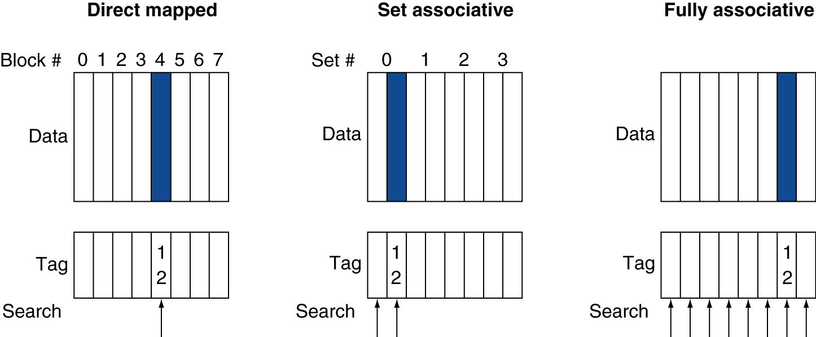
Associative Cache Example

Slide 24
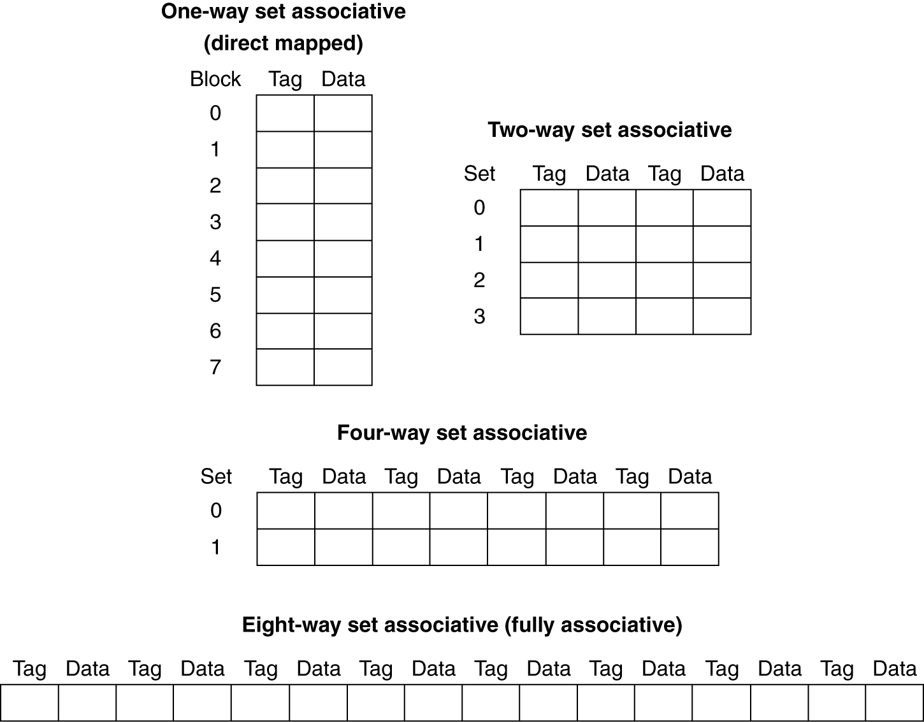
Spectrum of Associativity
For a cache with 8 total entries
1-Way Set Associative
2-Way Set Associative
4-Way Set Associative
8-Way Set Associative (fully associative)

